Slide 1
Inter-Process Communication using Pipes
CIS 370, Fall 2009
UMassD

Slide 2
The pipe
A pipe is typically used as a one-way communications channel which couples one related process to another.
UNIX deals with pipes the same way it deals with files.
A process can send data ‘down’ a pipe using a write system call and another process can receive the data by using read at the other end.

Slide 3
Pipes at the command level
pr mydoc | lpr -Psunhp
This command causes the shell to start the command pr and lpr simultaneously.
The ‘|’ symbol in the command line tells the shell to create a pipe to couple the standard output of pr to the standard input of lpr.
The final result of this command should be a nicely paginated version of the file mydoc sen to the sunhp printer.

Slide 4
Dissecting the pipe
The pr program on the left side of the pipe does not know that its stdout is being sent to a pipe.
The pr program simply writes to the stdout
Similarly the lpr program does not know that it is getting its input from a pipe.
The lpr program simply reads the stdin.
I.E. the programs behave normally.

Slide 5
Pipes
The overall effect is logically as if the following sequence has been executed.
  $ pr mydoc > sometempfile
  $ lpr -Psunhp sometempfile
  $ rm sometempfile
Flow control is maintained automatically by the OS (if pr write faster than lpr can handle, pr is suspended, till lpr catches up).
Command level input:stdin, output:stdout

Slide 6
Programming with pipes
Within programs a pipe is created using a system call named pipe.
If successful, this call returns two files descriptors: one for writing down the pipe, and one for reading from it.
Usage
  #include <unistd.h>
  int pipe(int filedes[2]);

Slide 7
Programming with pipes
filesdes is a two-integer array that will hold the file descriptors that will identify the pipe
If successful, filedes[0] will be open for reading from the pipe and filedes[1] will be open for writing down it.
pipe can fail (returns -1) if it cannot obtain the file descriptors (exceeds user-limit or kernel-limit).

Slide 8
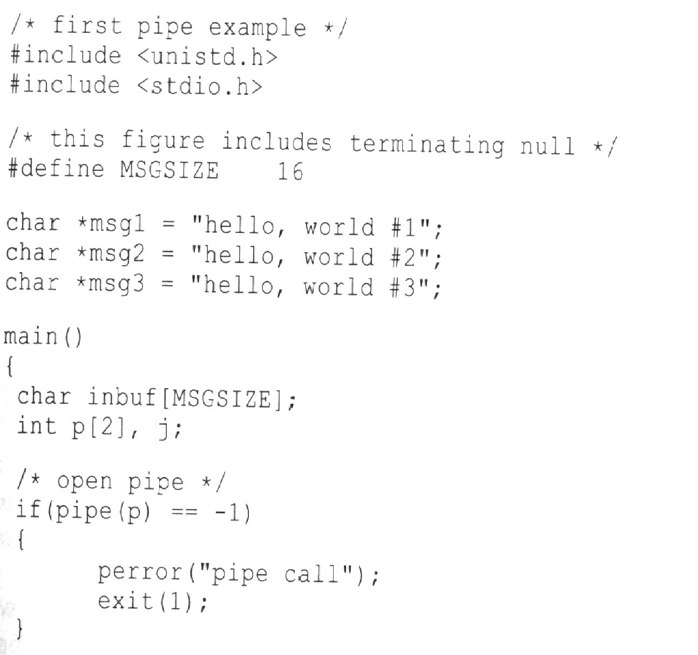

Slide 9
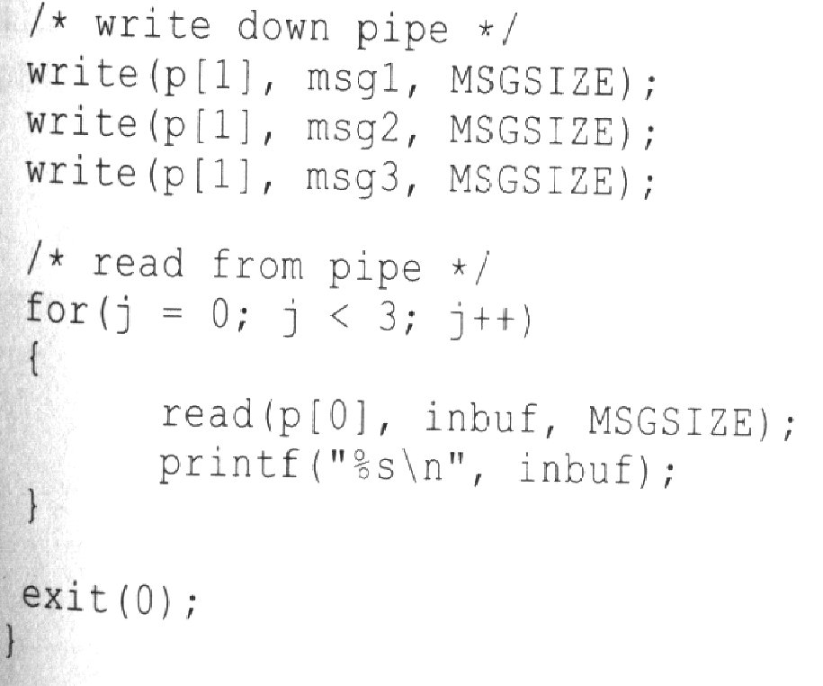

Slide 10
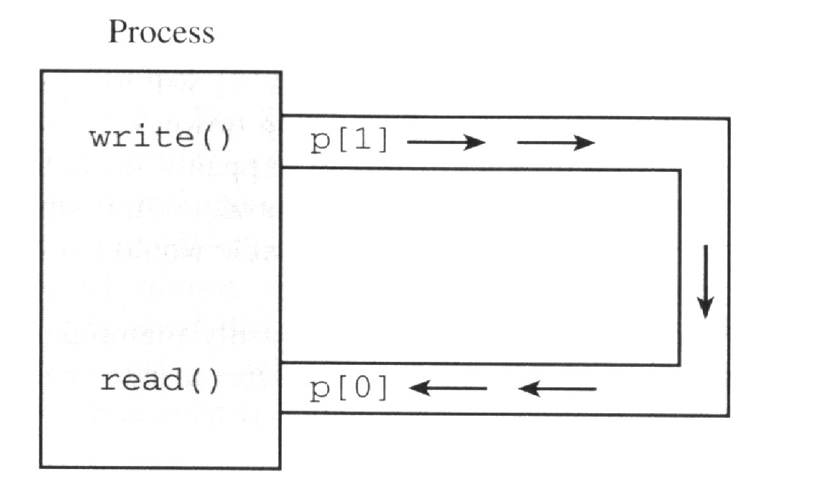
The output of the program :
  hello, world #1
  hello, world #2
  hello, world#3

Slide 11
More about pipes
pipes behave first-in-first-out, this cannot be changed, as lseek will not work in pipes
The size of the read and write don’t have to match (you can write 512 bytes per time while reading 1 byte per time)
This example is trivial as there is only one process involved and the process is sending messages to itself.
Pipes become powerful when used with fork

Slide 12
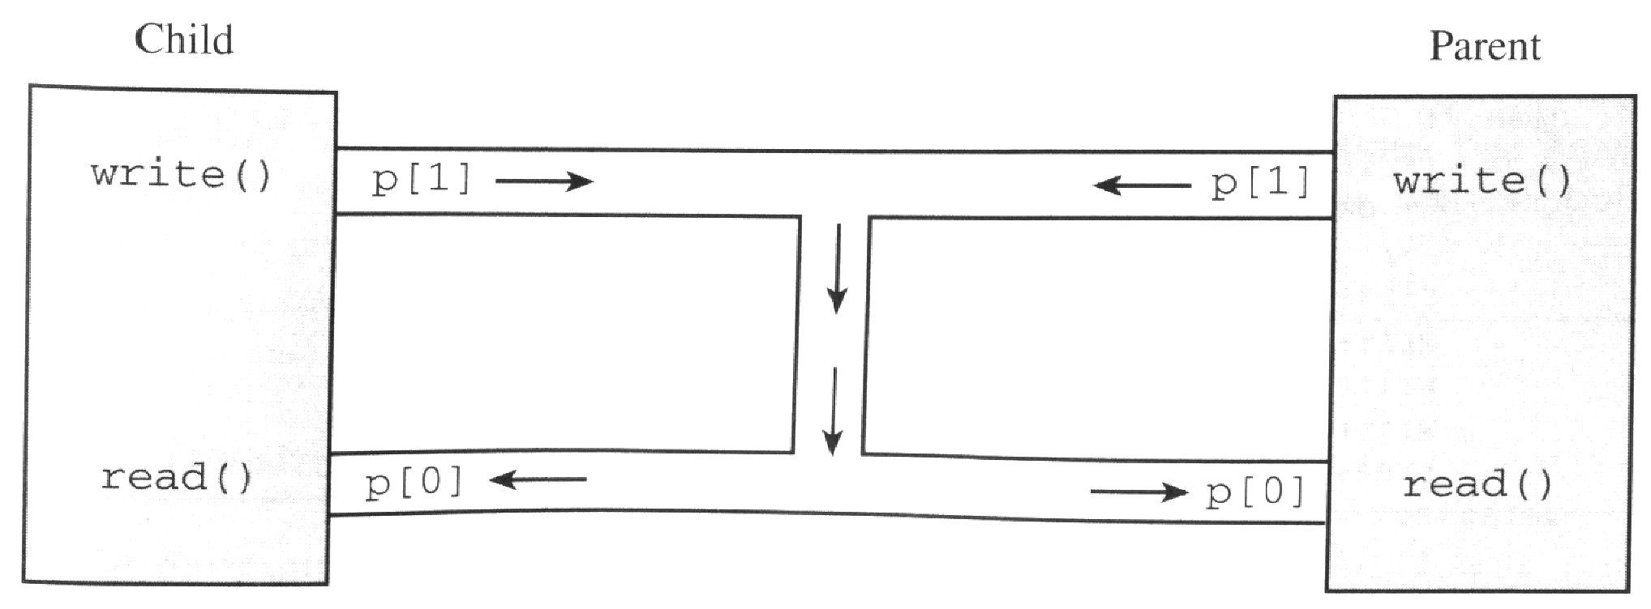
Do you see a problem here?
What happens if both attempt to write and read at the same time?
pipes are meant as uni-directional communication devices.

Slide 13
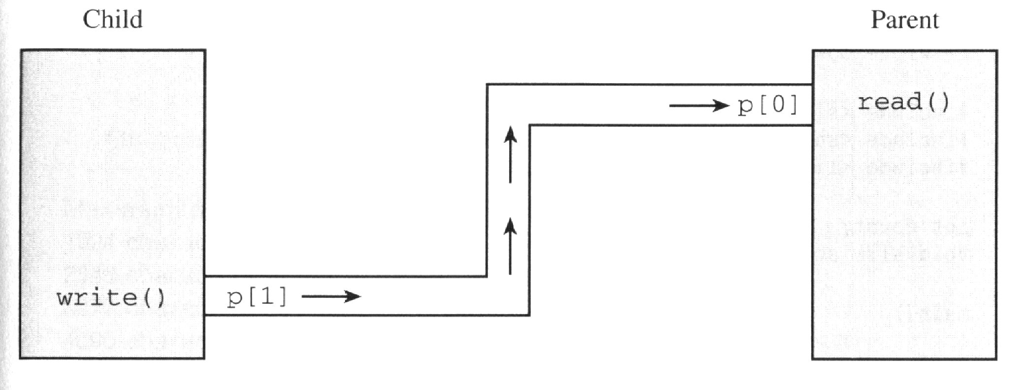
Other examples omitted. This is what you have to do in today’s lab!

Slide 14
The size of a pipe
It is important to note that the size of a pipe is finite.
Typically at least 512 bytes (system dependent)
Knowing this size ahead of time enables you to write and read more efficiently.
If a write fills the pipe, the write is suspended till a read can create more space

Slide 15
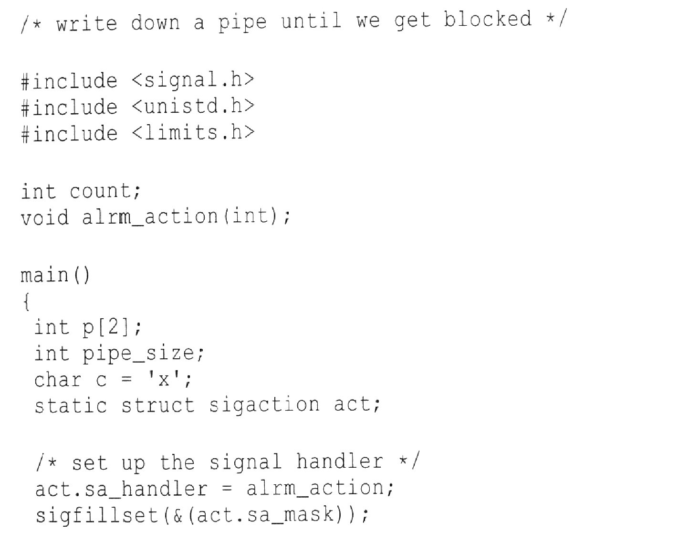

Slide 16
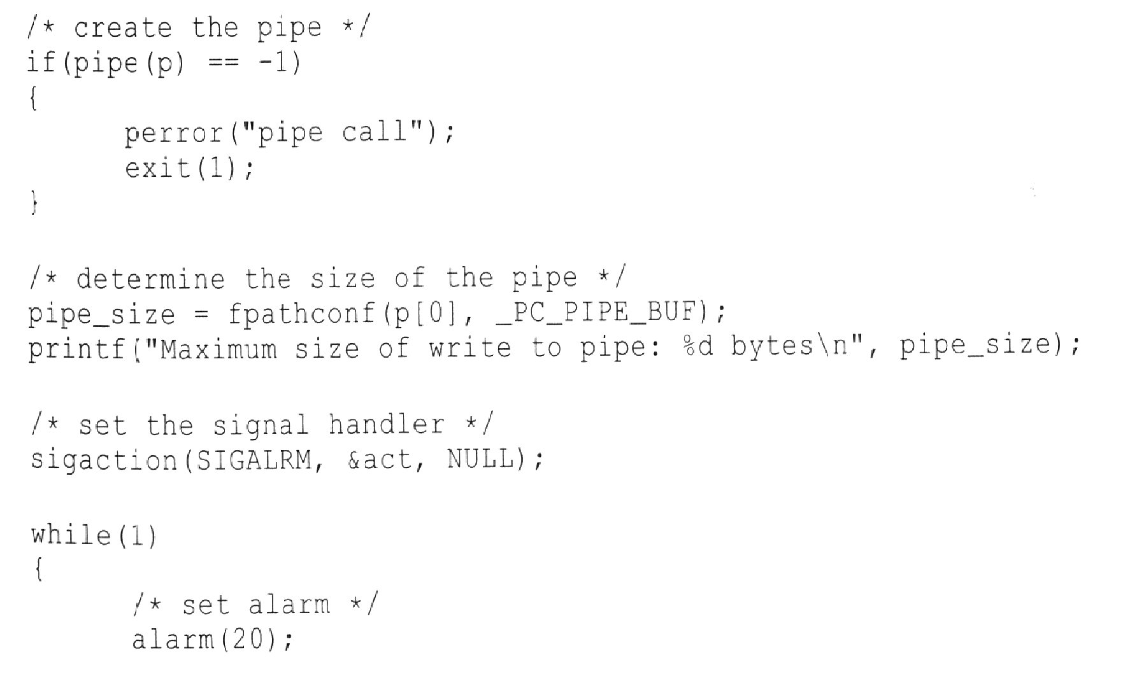

Slide 17
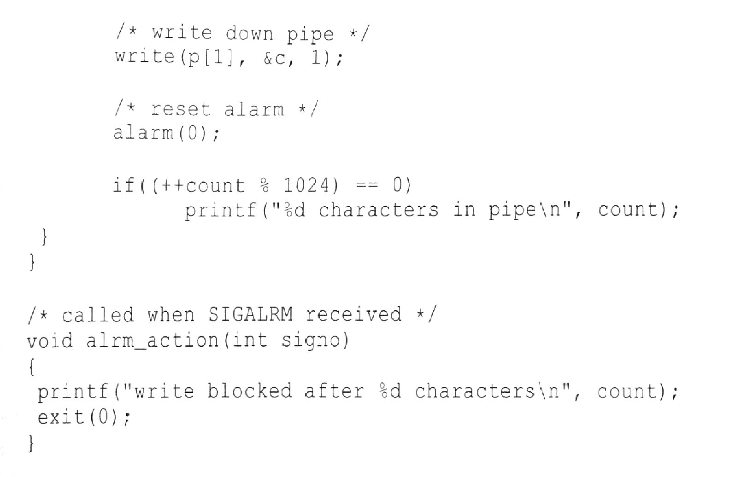

Slide 18
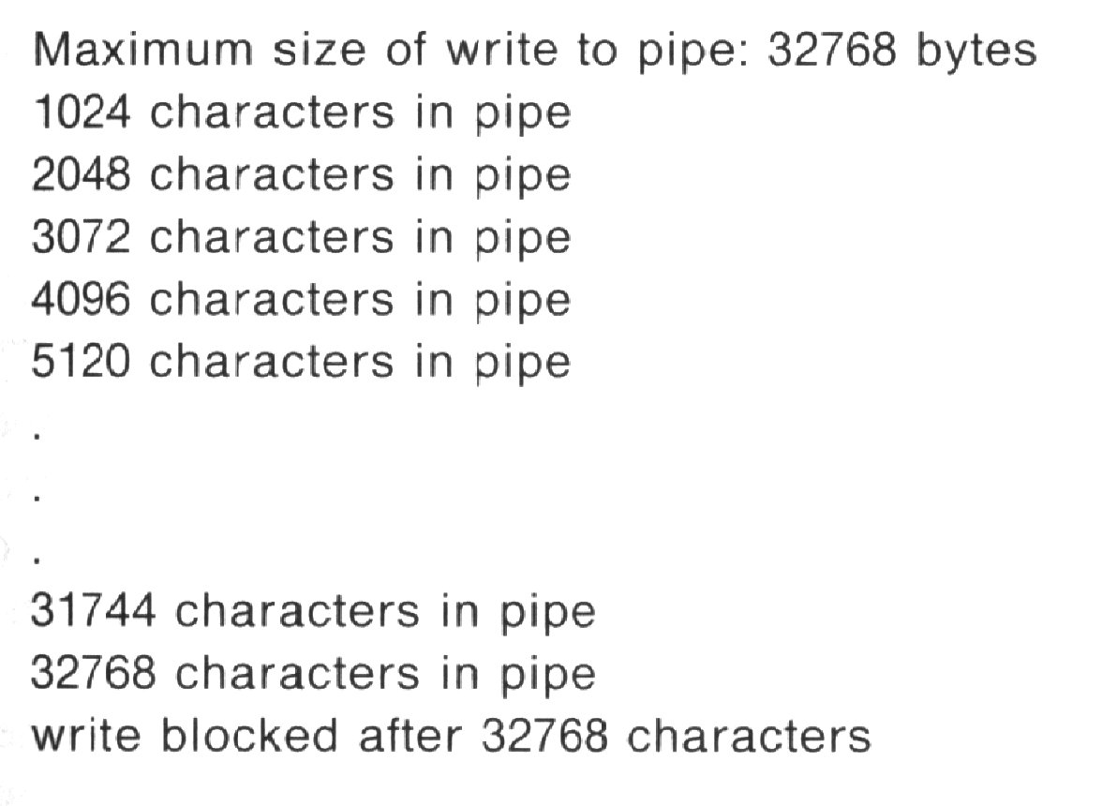

Slide 19
Blocking reads and writes
When a process attempts a single write larger than the size of the pipe, the write is suspended till a read ensues.
If several processes write to the pipe at the same time, data can be intermingled.
If the pipe is empty and a process attempts read, it is usually blocked, till some data is placed in the pipe.
read will return even if less than expected.

Slide 20
Closing pipes
Closing the write file descriptor
  if all processes close their write-end of the pipe and the pipe is empty, any process attempting a read will return no data (will return 0 like EOF)
Closing the read file descriptor
  if all processes close their read-end of the pipe and there are processes waiting to write to the pipe, the kernel will send a SIGPIPE signal. IF the signal is not caught the process will terminate, if caught will process the ISR (-1 ret)

Slide 21
Non-blocking reads and writes
Normally both reads and writes can block.
Sometimes, we may not want this - execute an error routine, pool for other pipes.
Two ways exist for making reads and writes non-blocking
  the first is to use fstat on the pipe, the st_size field in the stat structure returns the number of characters in the pipe. If a single read this is fine, if multiple reads, a read could occur between fstat and read.

Slide 22
Non-blocking reads and writes
The second method is to use fcntl.
Among other things it allows a process to set the O_NONBLOCK flag for a file des.
This prevents future reads and writes from blocking.
#include<fcntl.h>
...
if(fcntl(filedes, F_SETFL, O_NONBLOCK) == -1)
perror(“fcntl”);

Slide 23
Non-blocking
If the filedes was the write file descriptor for a pipe, then future calls to write would never block if the pipe was full
They would return a -1 immediately.
Similarly, if filedes represented the read-end of a pipe, then a process would immediately return a -1, if there was no data in the pipe, instead of sleeping.

Slide 24
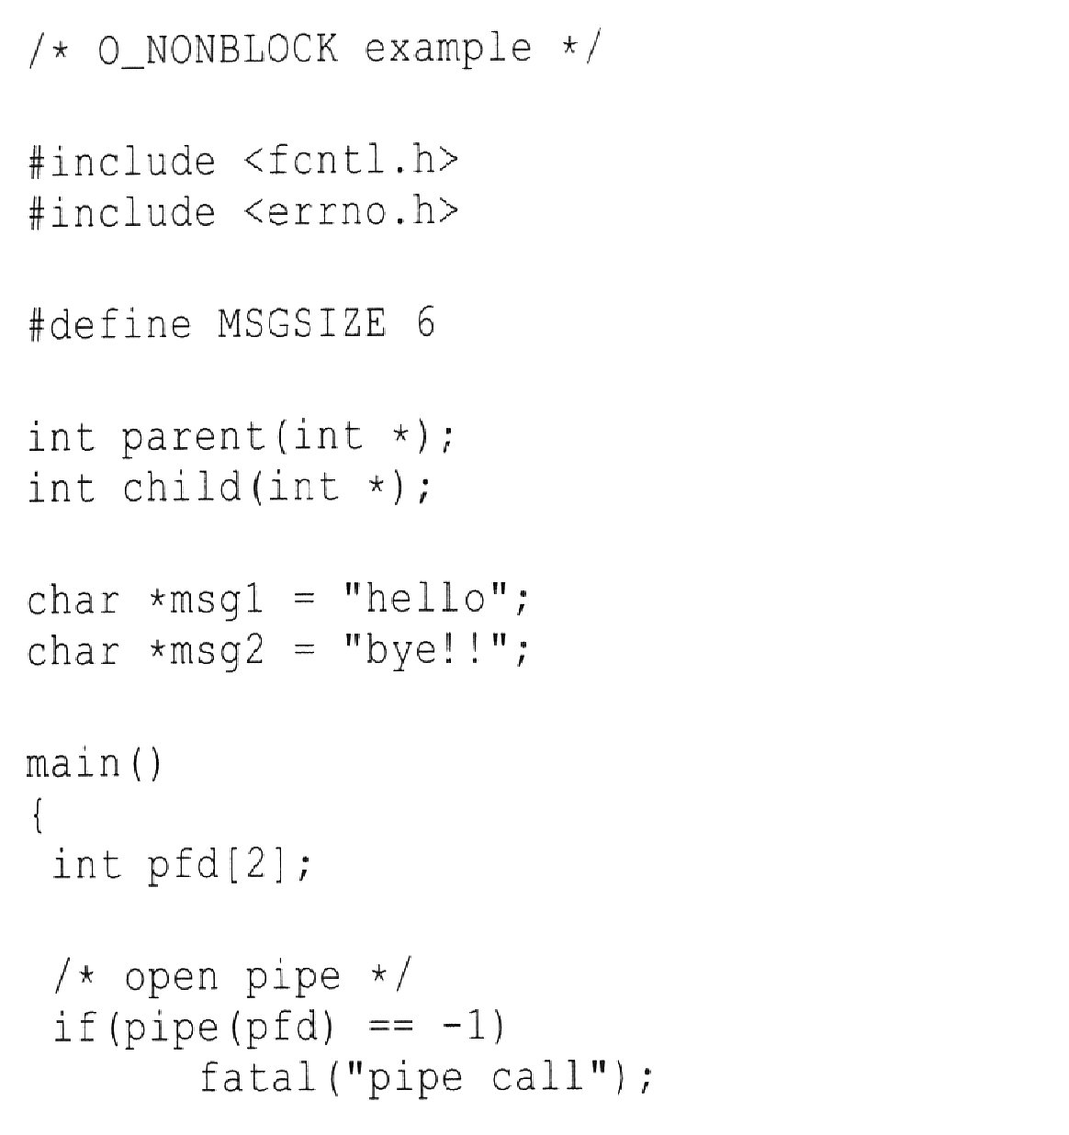

Slide 25
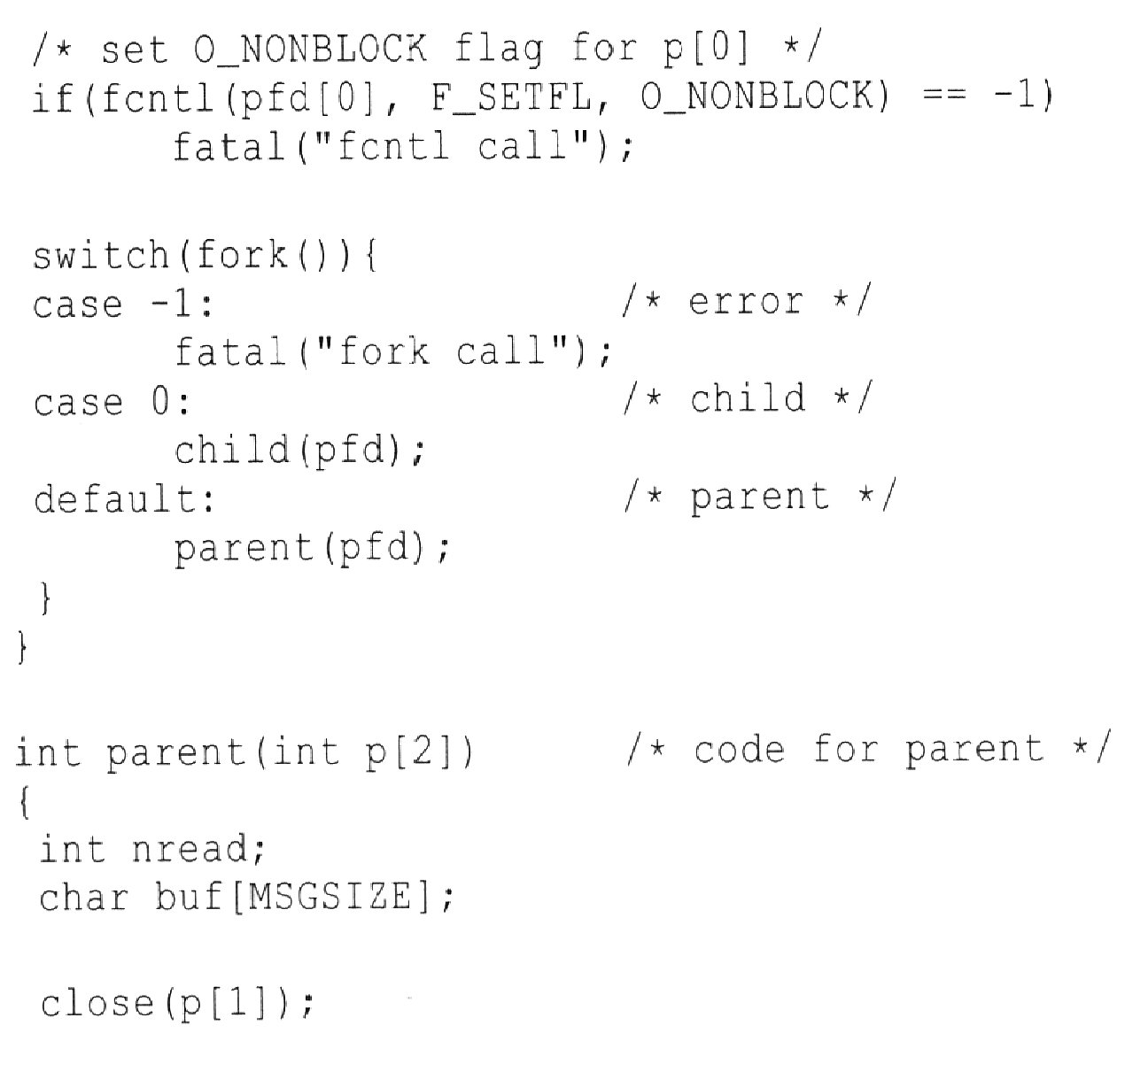

Slide 26
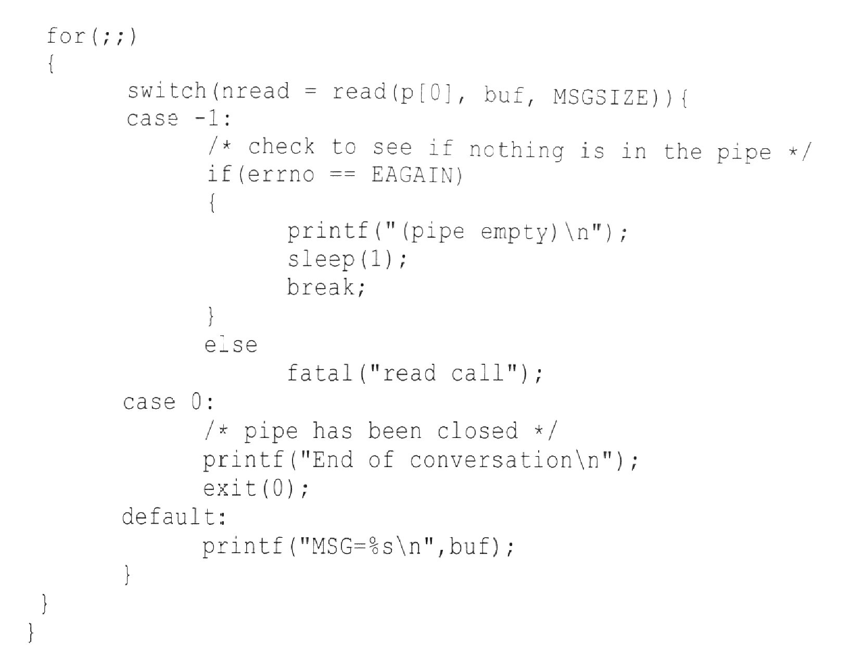

Slide 27
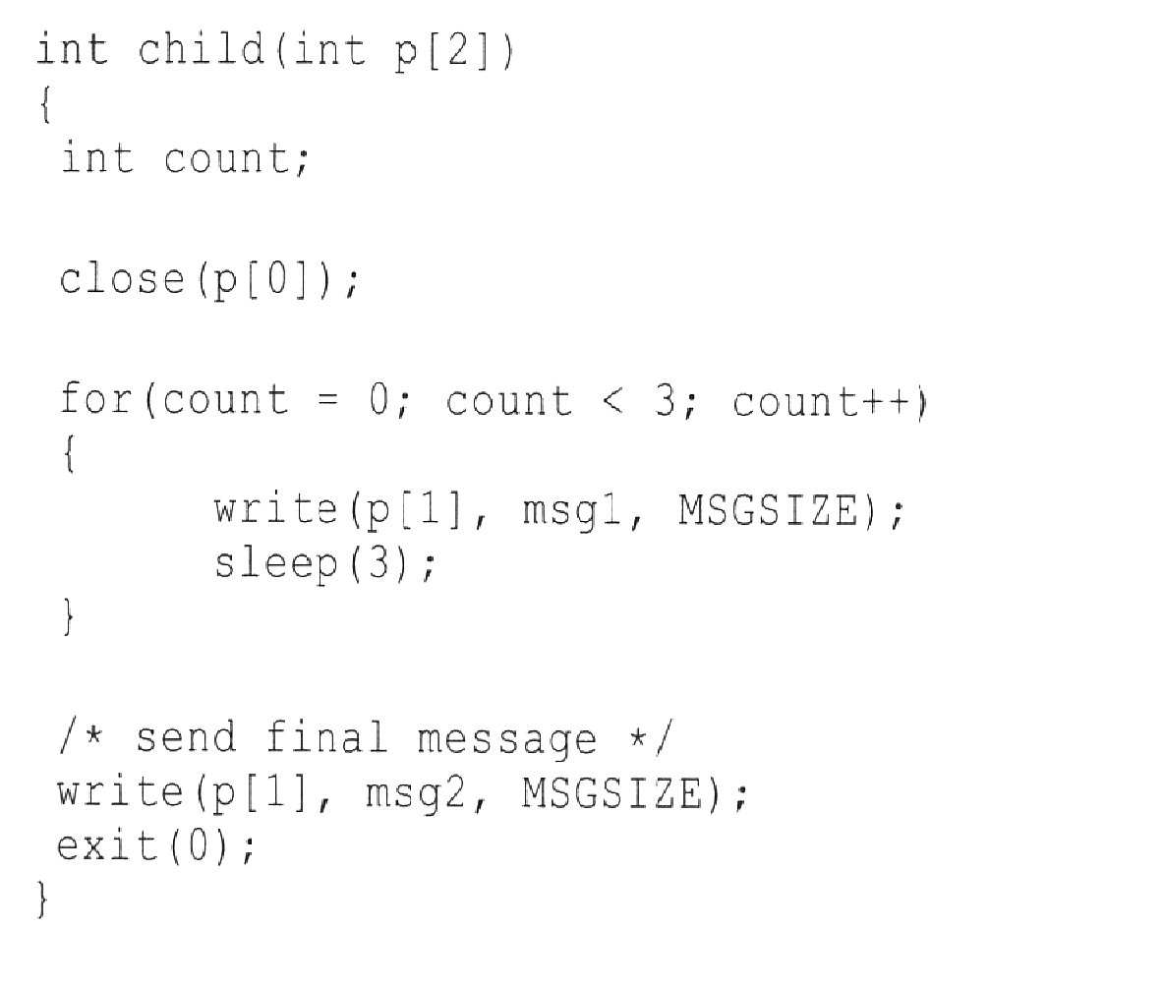

Slide 28
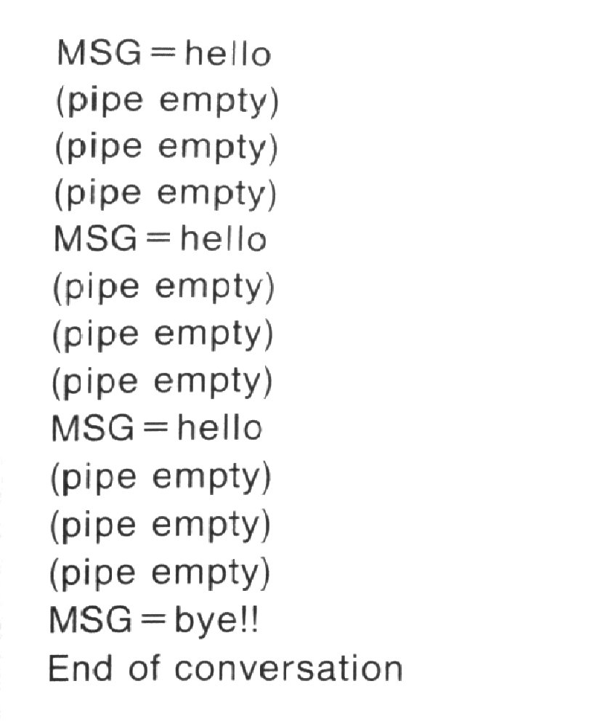

Slide 29
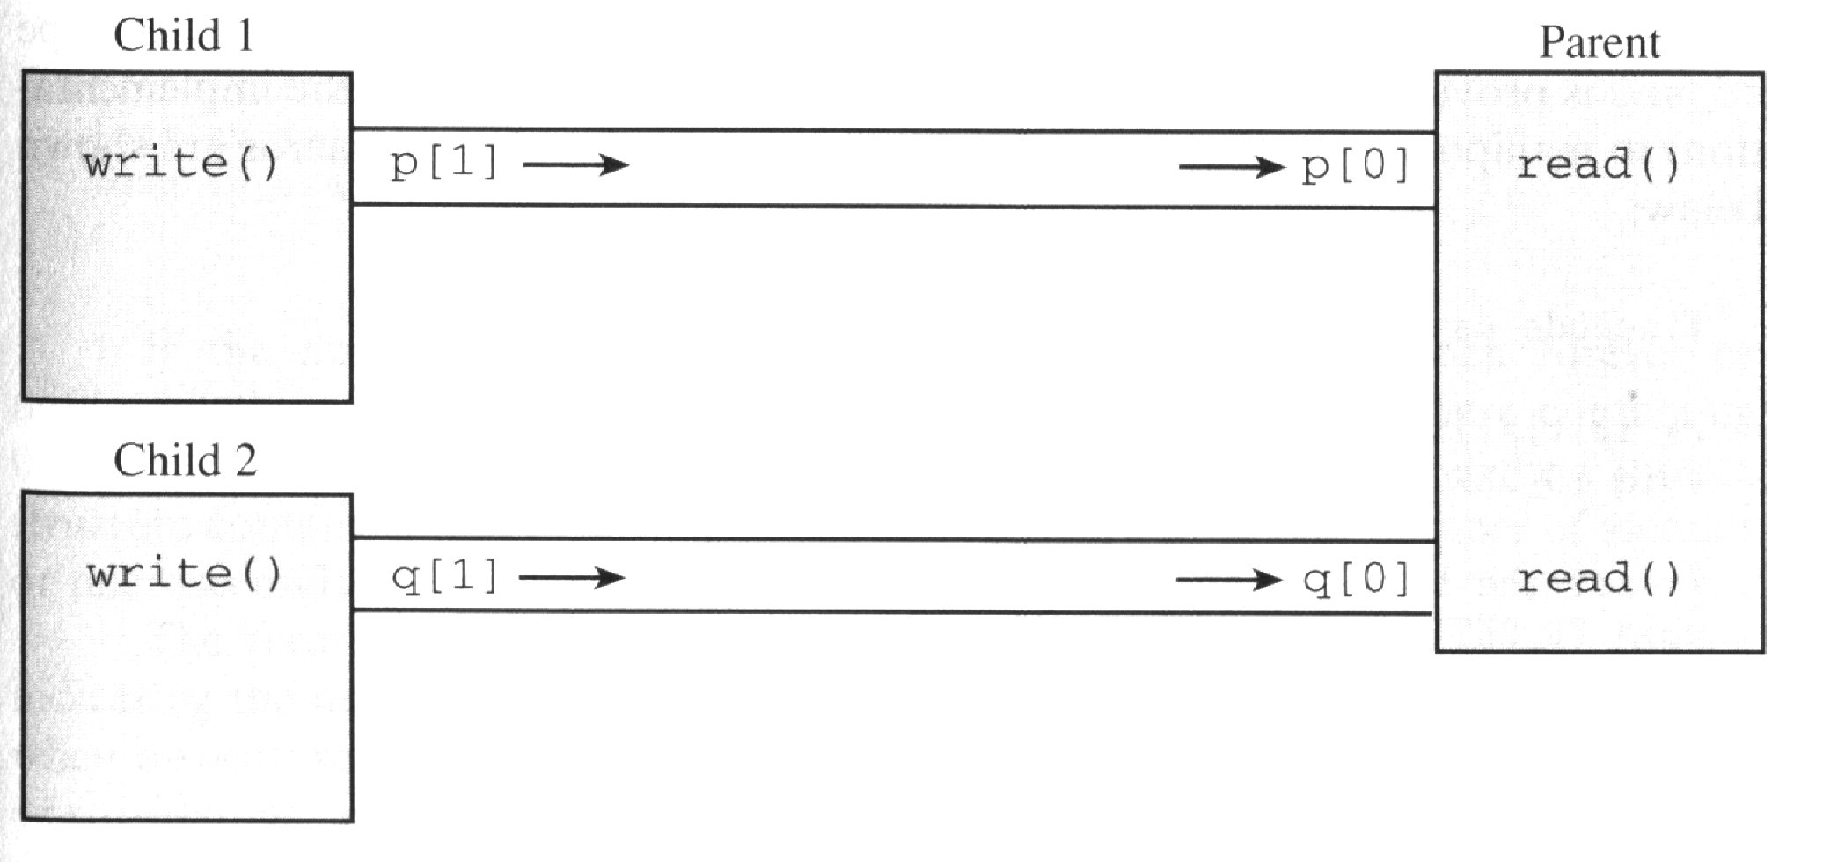
Using select to handle multiple pipes
Consider the case where the parent process acts as a server process with several child processes acting as clients.

Slide 30
The select system call
Usage
  #include <sys/time.h>
  int select(int nfds, fd_set *readfds, fd_set *writefds, fd_set *errorfds, struct timeval *timeout);
  The first parameter tells the select the number of file descriptors which are potentially of interest to the server. (this would have to include stdin, stdout, and stderr)

Slide 31
The second through the fourth are pointers to bit masks, with each bit representing a file descriptor. If a bit is turned on, it denotes an interest in the relevant fd.
readfds asks if there is anything worth reading
writefds asks if there is any of the given fds are ready to accept a write
errorfds asks if an exception has been raised by the given fd.
As bit manipulation might be non-portable, an ADT fd_set is created, with macros.

Slide 32
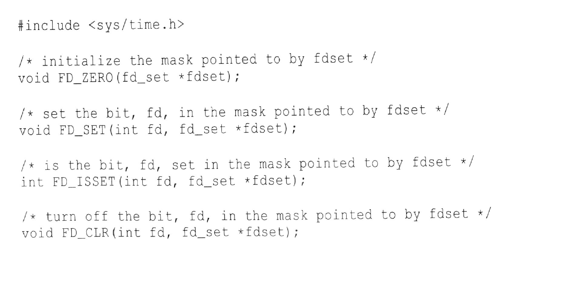

Slide 33
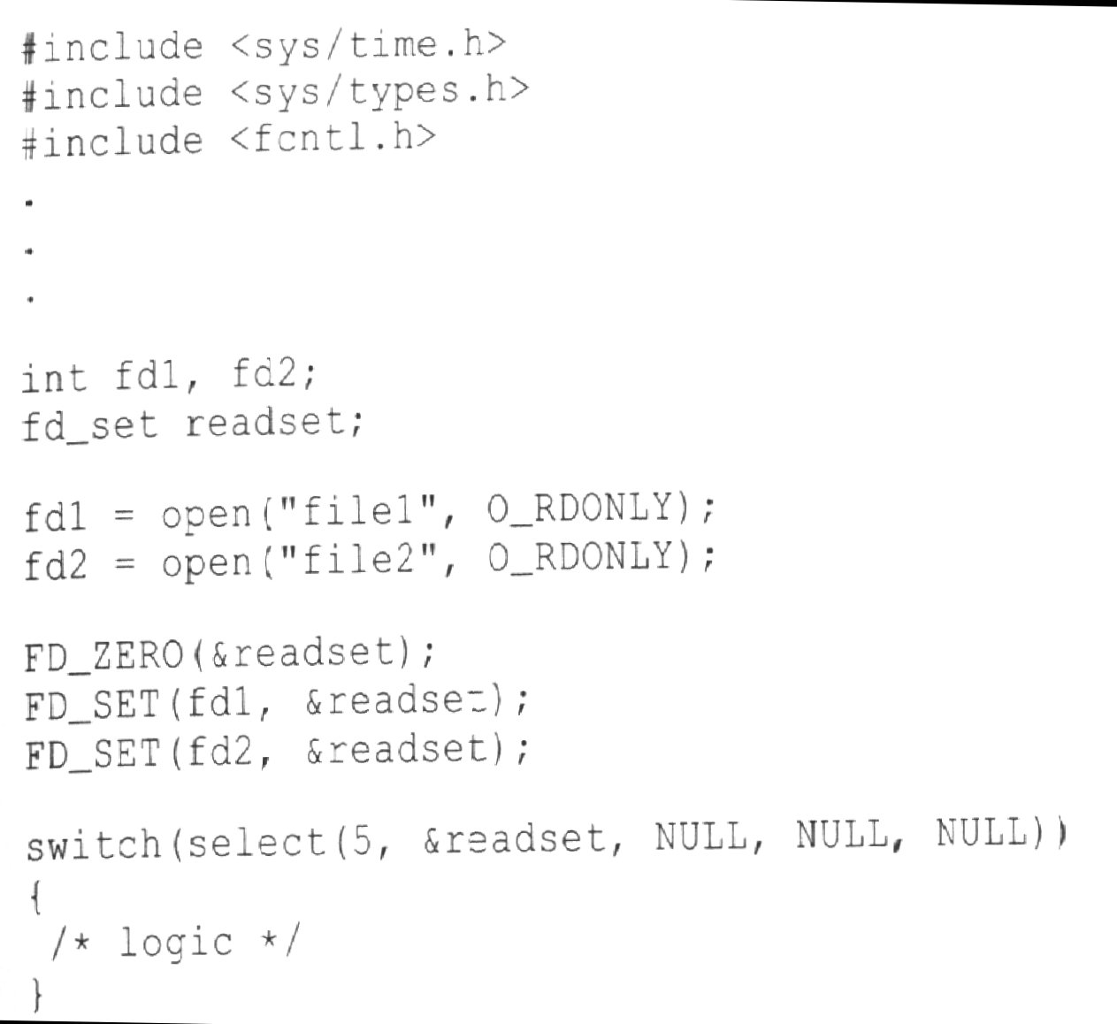

Slide 34
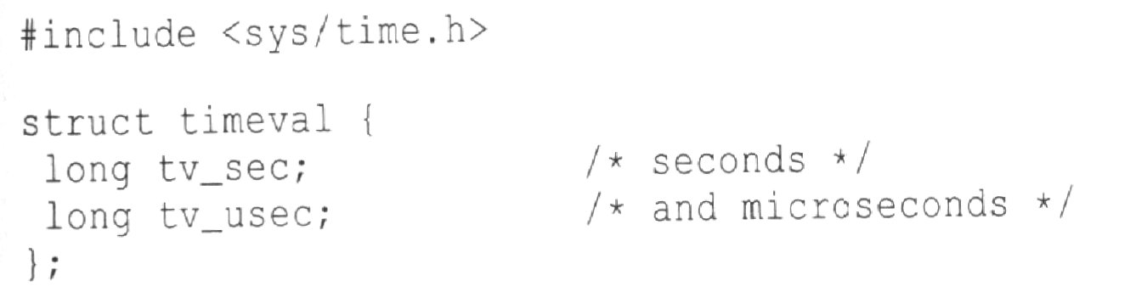
The select system call cont.
The fifth parameter to select, timeout is a pointer to a struct timeval :
If NULL, select will block forever, if the timeout structure contains non-zero values, it will return after the delay.

Slide 35
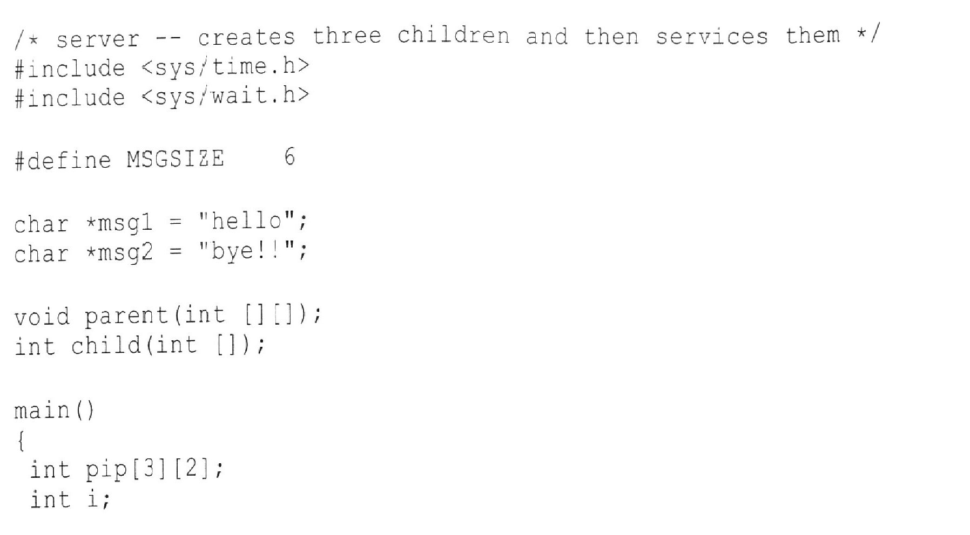
Client - Server

Slide 36
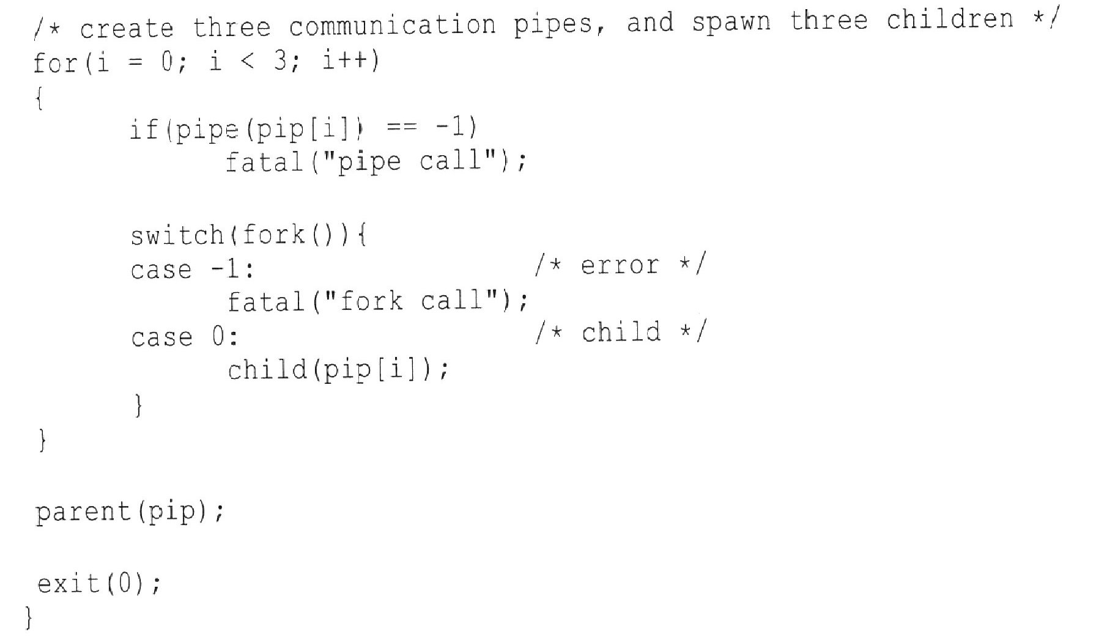

Slide 37
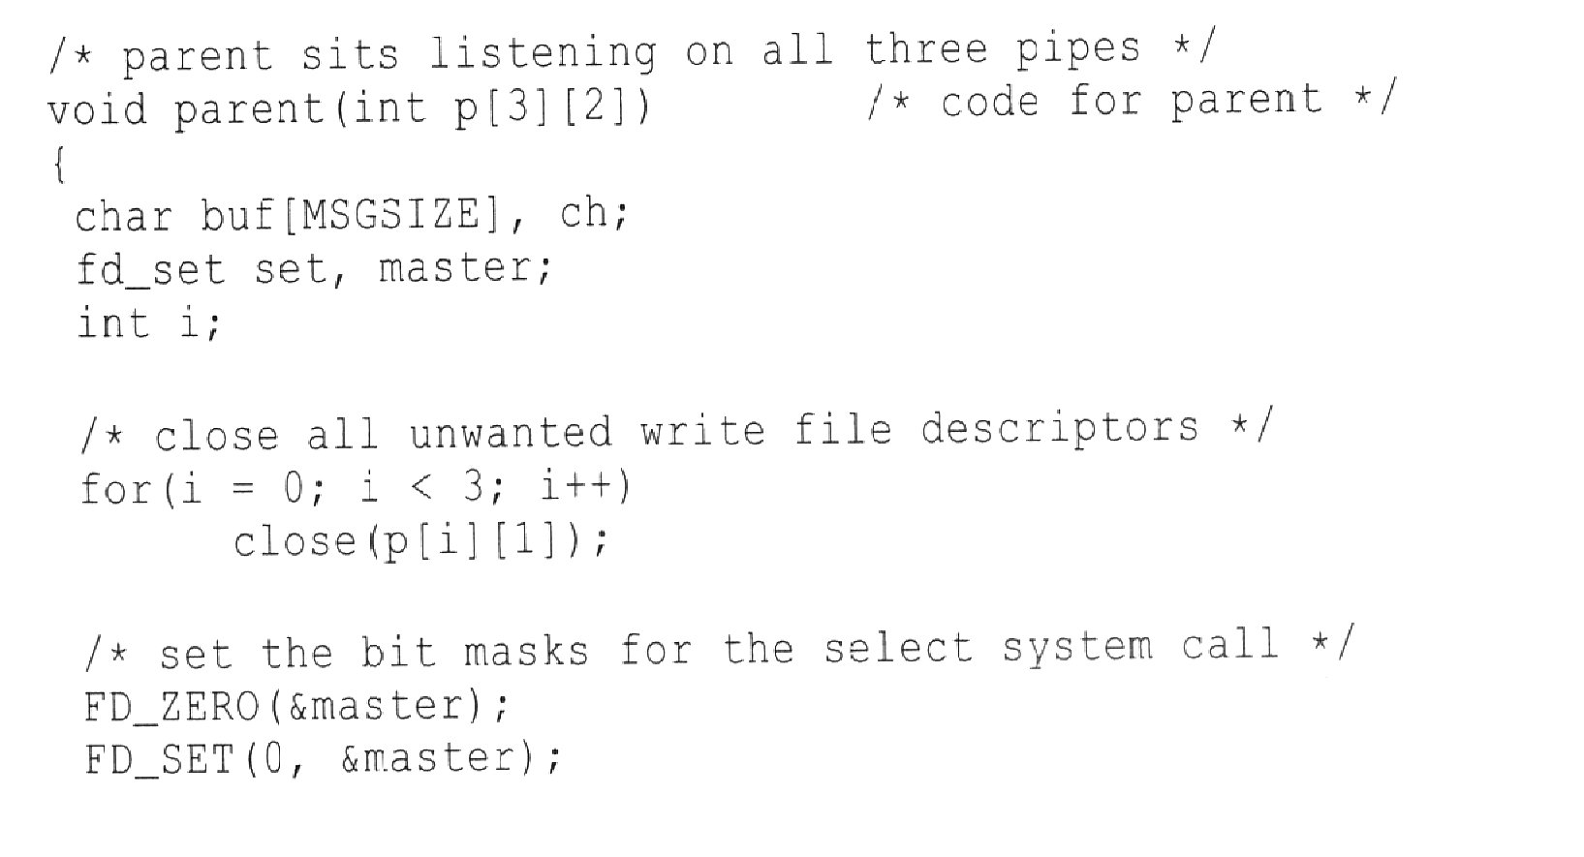

Slide 38
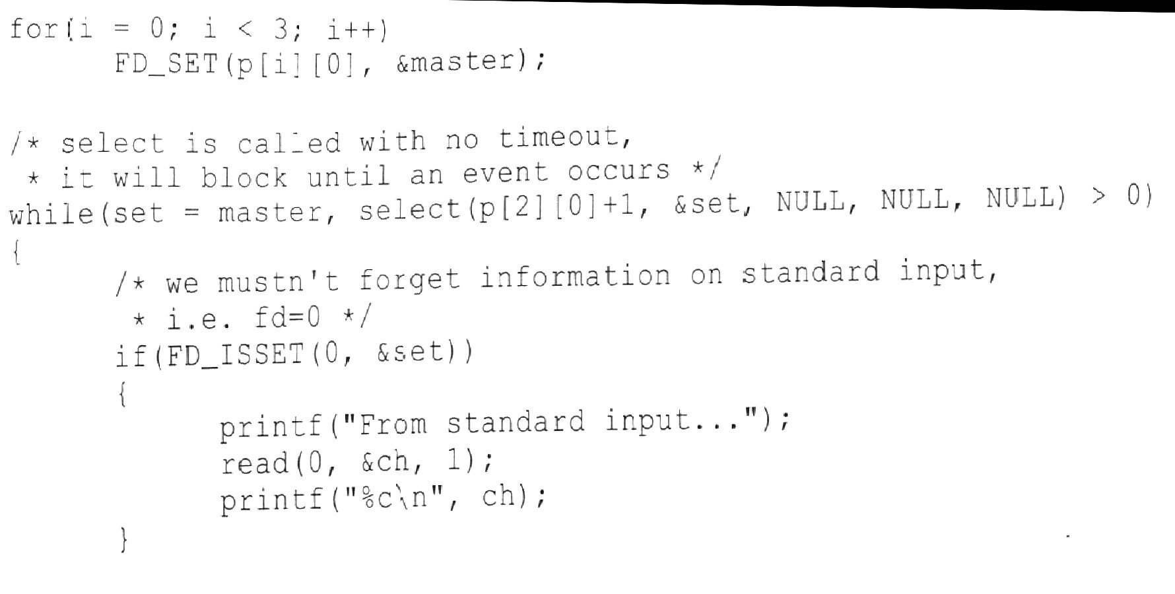

Slide 39
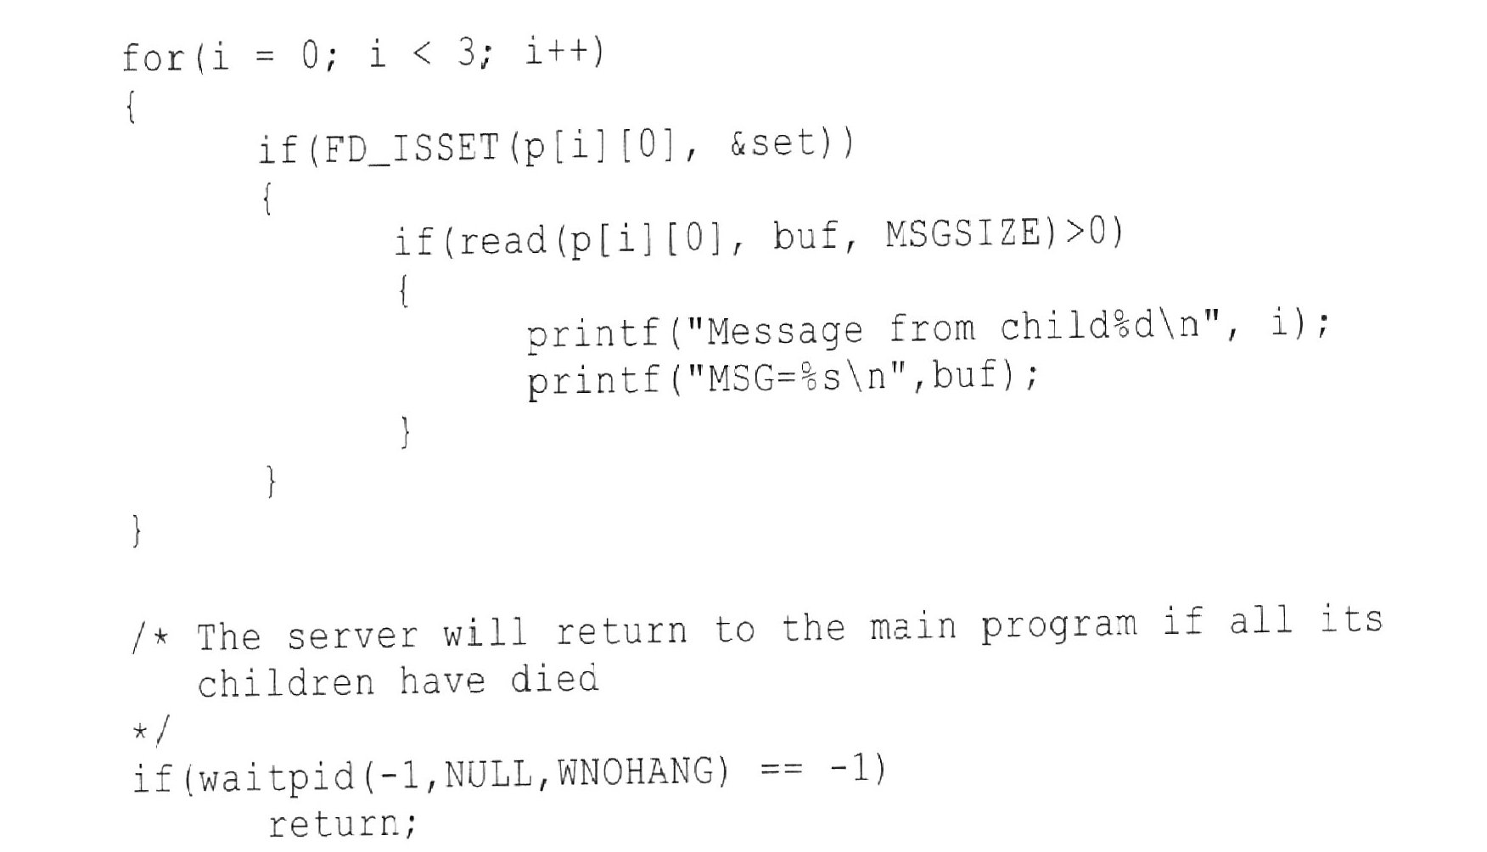

Slide 40
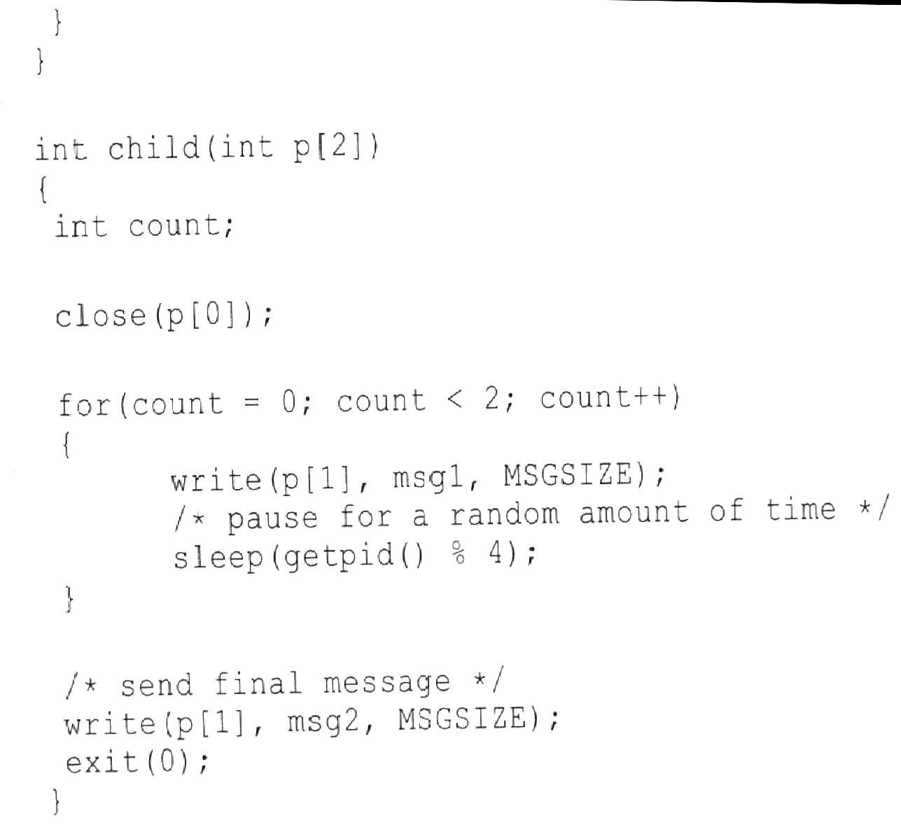

Slide 41
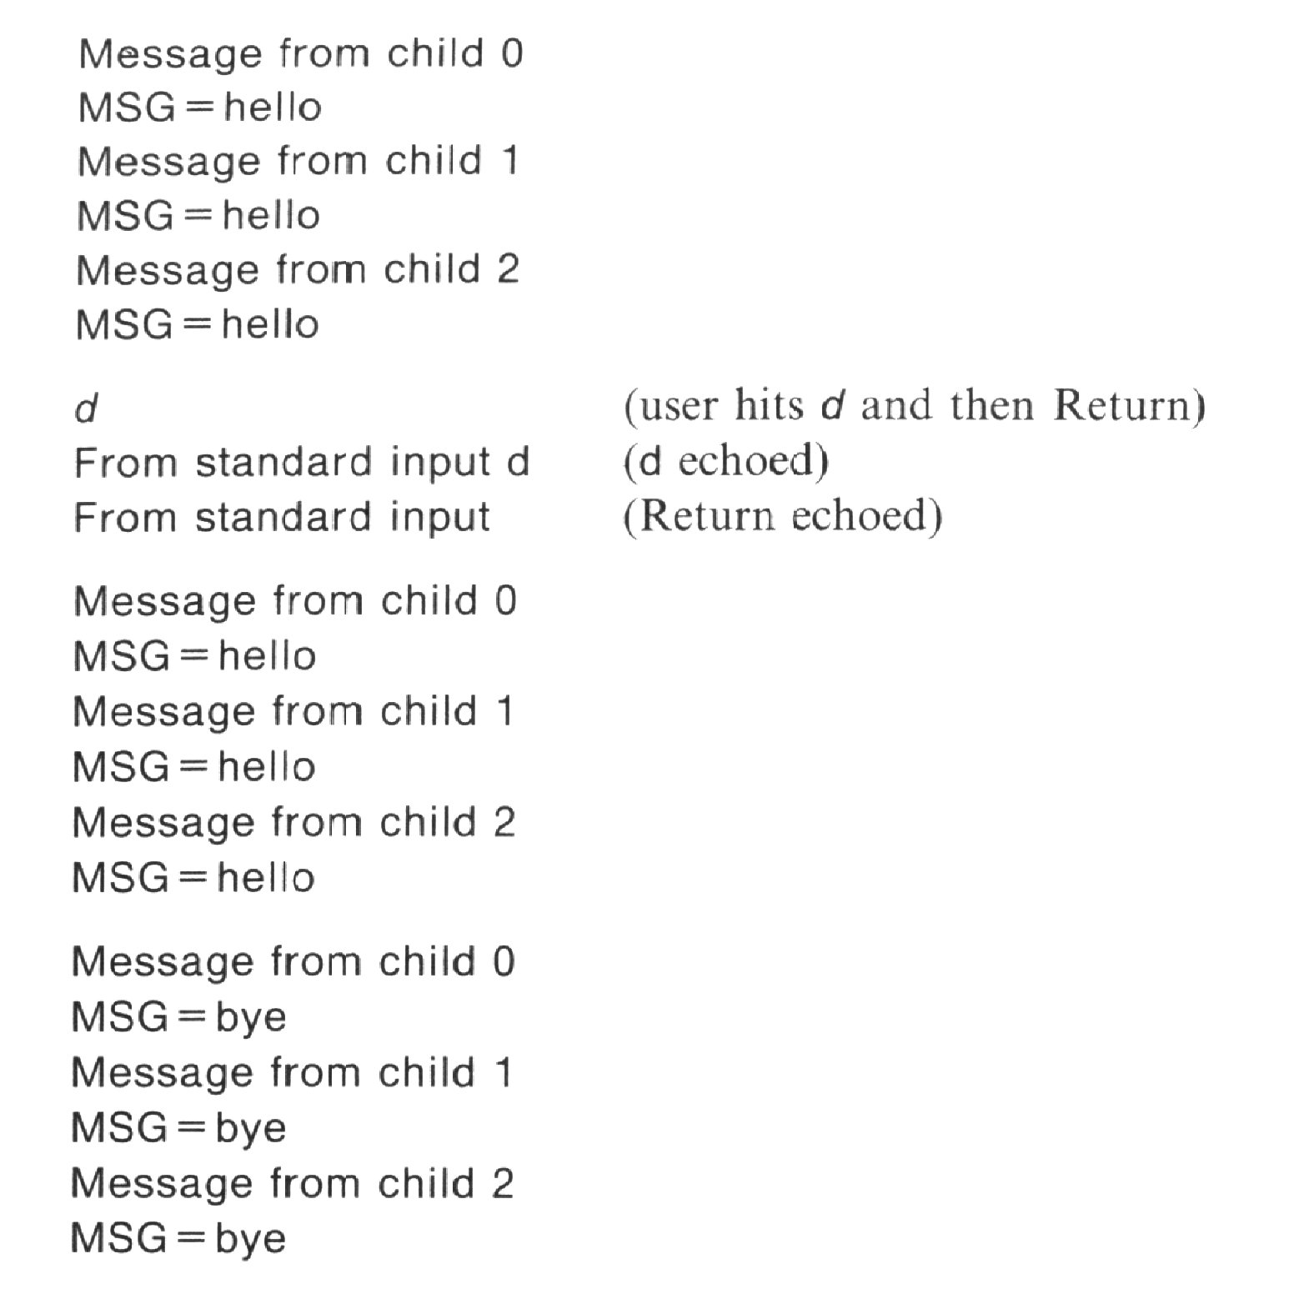

Slide 42
Pipes and exec system calls
Recall how a pipe can be set up between two programs at the shell level:
  $ ls | wc
How does this work?
Open file descriptors are kept open, by default, across exec calls.
The output of ls is coupled with the input of wc, using either fcntl or dup2.

Slide 43
dup2
As you know stdin, stdout, and stderr have respectively, file descriptors 0, 1 and 2.
A programmer could, for example, couple stdout to another file descriptor using dup2.
Note that dup2 closes the file represented by its second parameter before the assignment.

Slide 44
The join example
The example join shows the piping mechanism employed by a shell in simplified form.
join takes two parameters, com1 and com2, each of which describes a command to be run. Both are actual arrays of character pointers that will be passed to execvp.
join will run both programs and pipe the stdout of com1 into the stdin of com2.

Slide 45
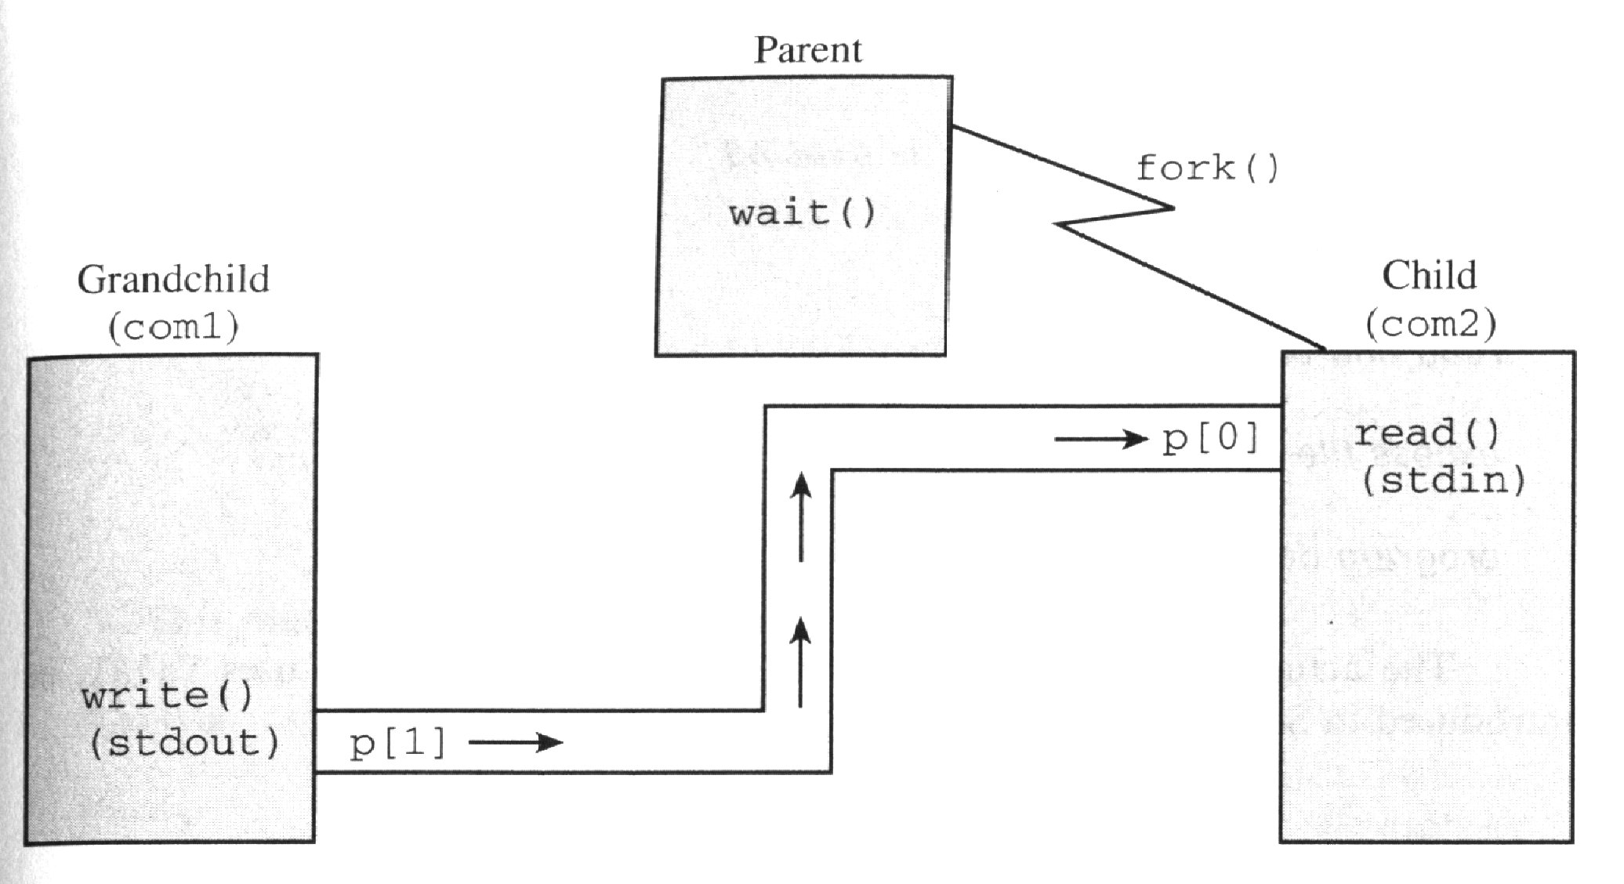

Slide 46
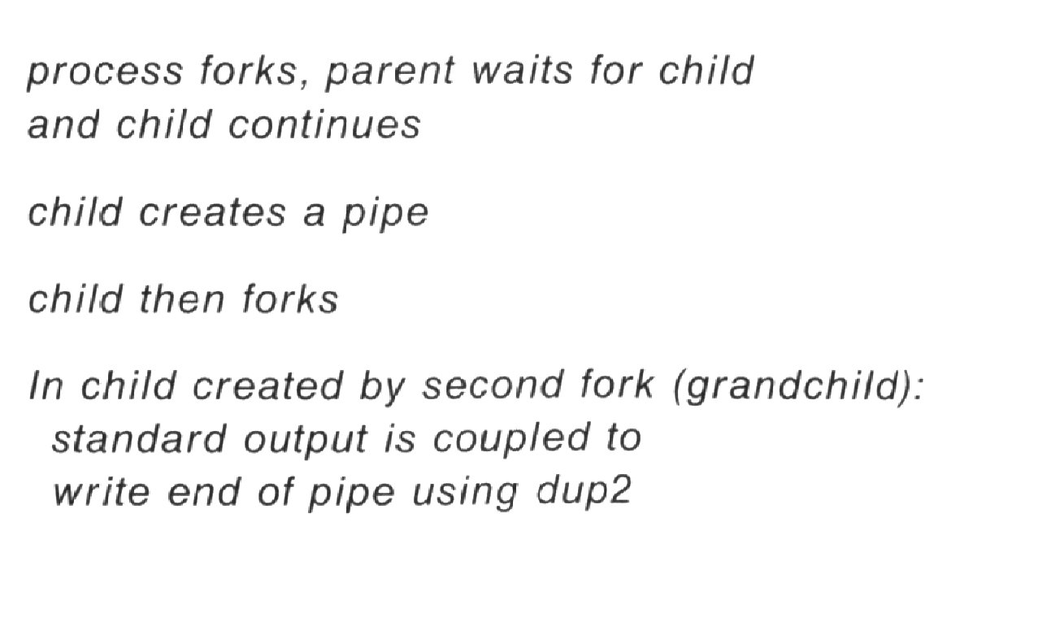
The join pseudo-code

Slide 47
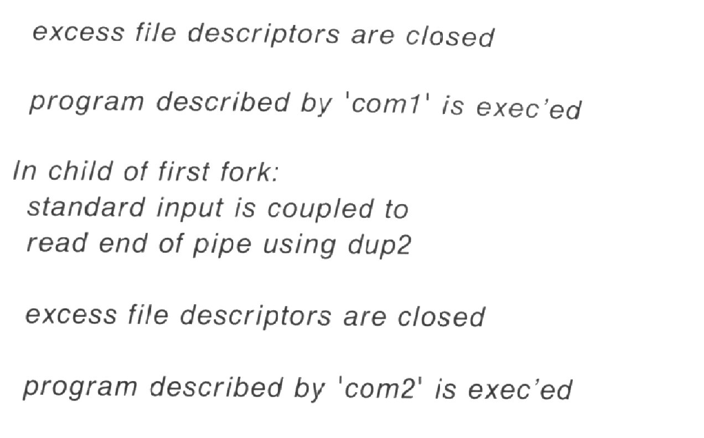
Pseudo-code continued

Slide 48
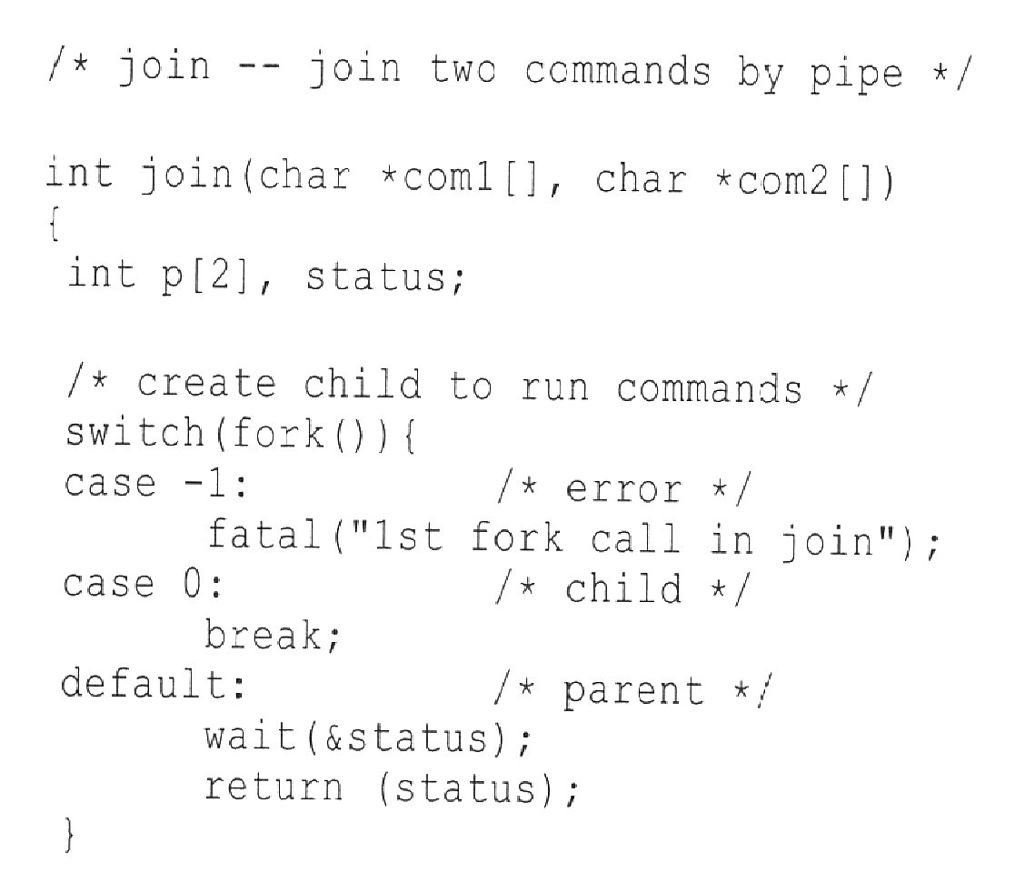

Slide 49
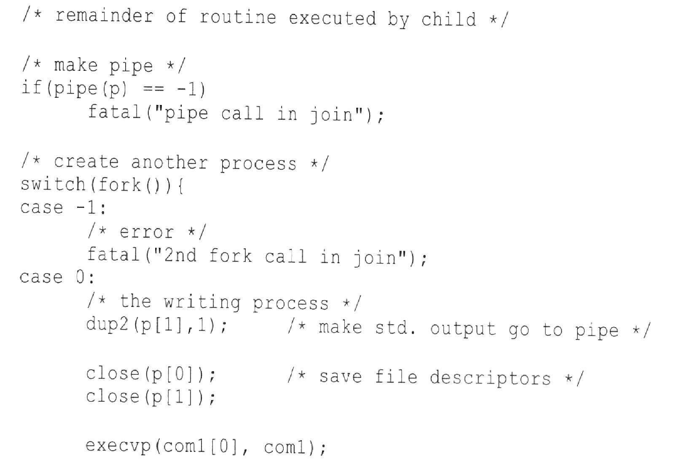

Slide 50
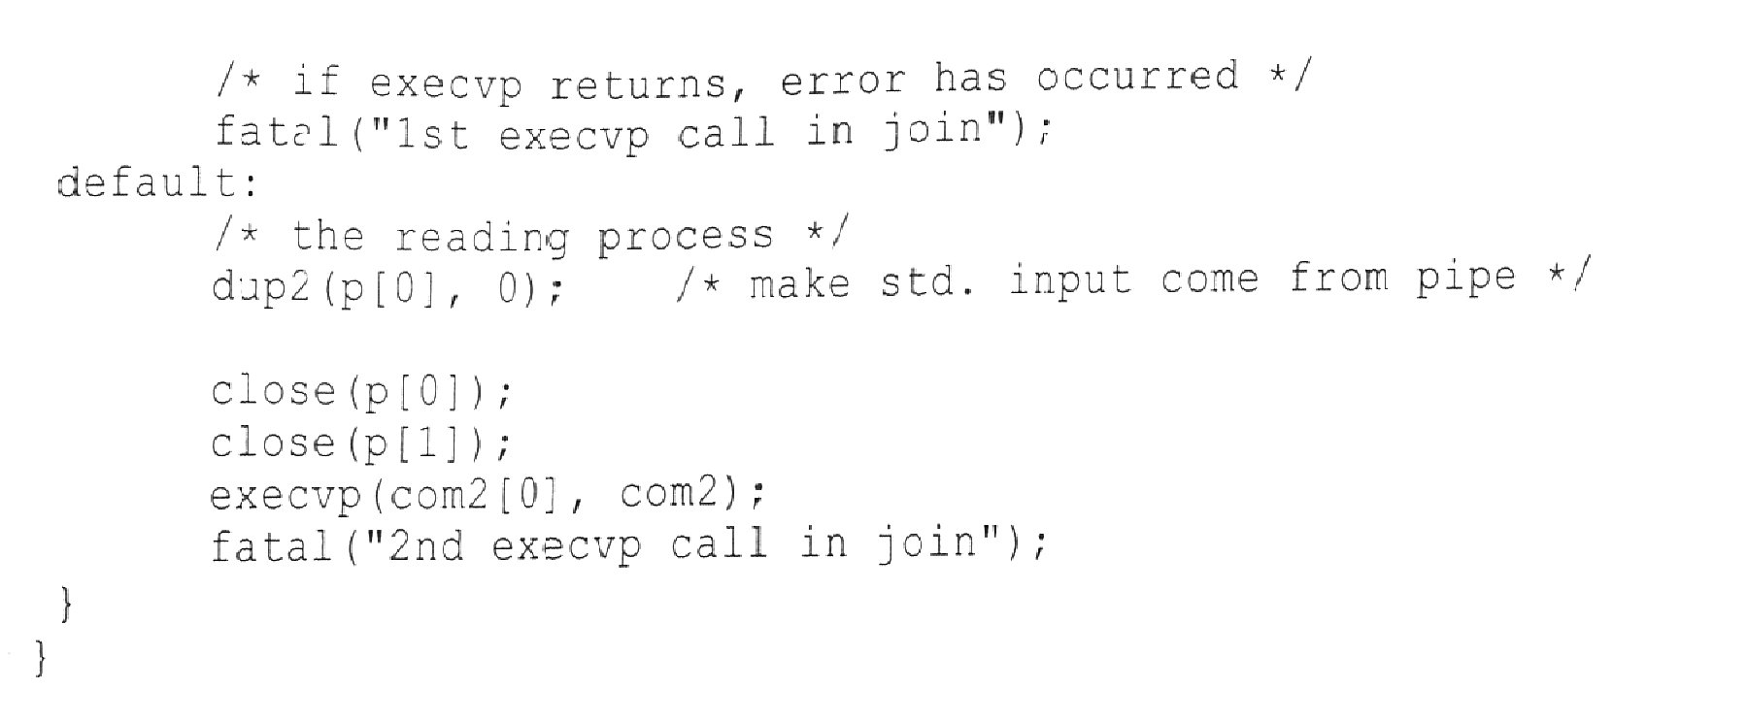
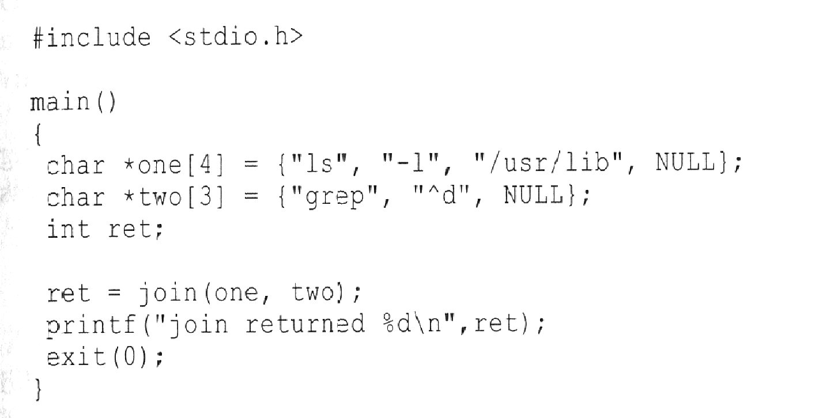

Slide 51
FIFOs (named pipes)
Pipes are an elegant and powerful IPC mechanism.
However they have several drawbacks
  pipes can only be shared between processes that share a common ancestry (true client - server?)
  pipes are temporary, they need to be created when needed and are destroyed when the program terminates.
To overcome these limitations UNIX provides FIFOs or named pipes.

Slide 52
FIFOs
For read and write commands they behave exactly like pipes - fifo.
FIFOs are permanent fixtures and are given UNIX file names.
FIFOs have an owner, size and access permissions.
They can be opened, closed and deleted like any other UNIX file, but are identical to pipes with read or write.

Slide 53
Command level FIFO
The command mknod is used to create a FIFO.
  $ /etc/mknod channel p
Here channel is the name of the FIFO.
The second argument p tells mknod to create a FIFO (mknod is also used to create device files).
ls -s
  prw-rw-r-- 1 ben usr 0 Jul 16 21:05 channel

Slide 54
More on FIFOs
The following example show a use for command-level FIFO
  $ cat < channel &
  [102]
  $ ls -l > channel; wait
  total 17
  .
  .
  .

Slide 55
Programming with FIFOs
For most parts, programming with FIFOs is identical to programming with pipes.
Usage
  #include <sys/types.h>
  #include <sys/stat.h>
  int mkfifo(const char *pathname, mode_t mode);

Slide 56
Programming with FIFOs
Once created, a FIFO must be opened using open.
  mkfifo(“/tmp/fifo”, 0666);
  .
  fd = open(“/tmp/fifo”, O_WRONLY);
This will open the created FIFO for write only. This open will be blocked till a read end is opened by another process.

Slide 57
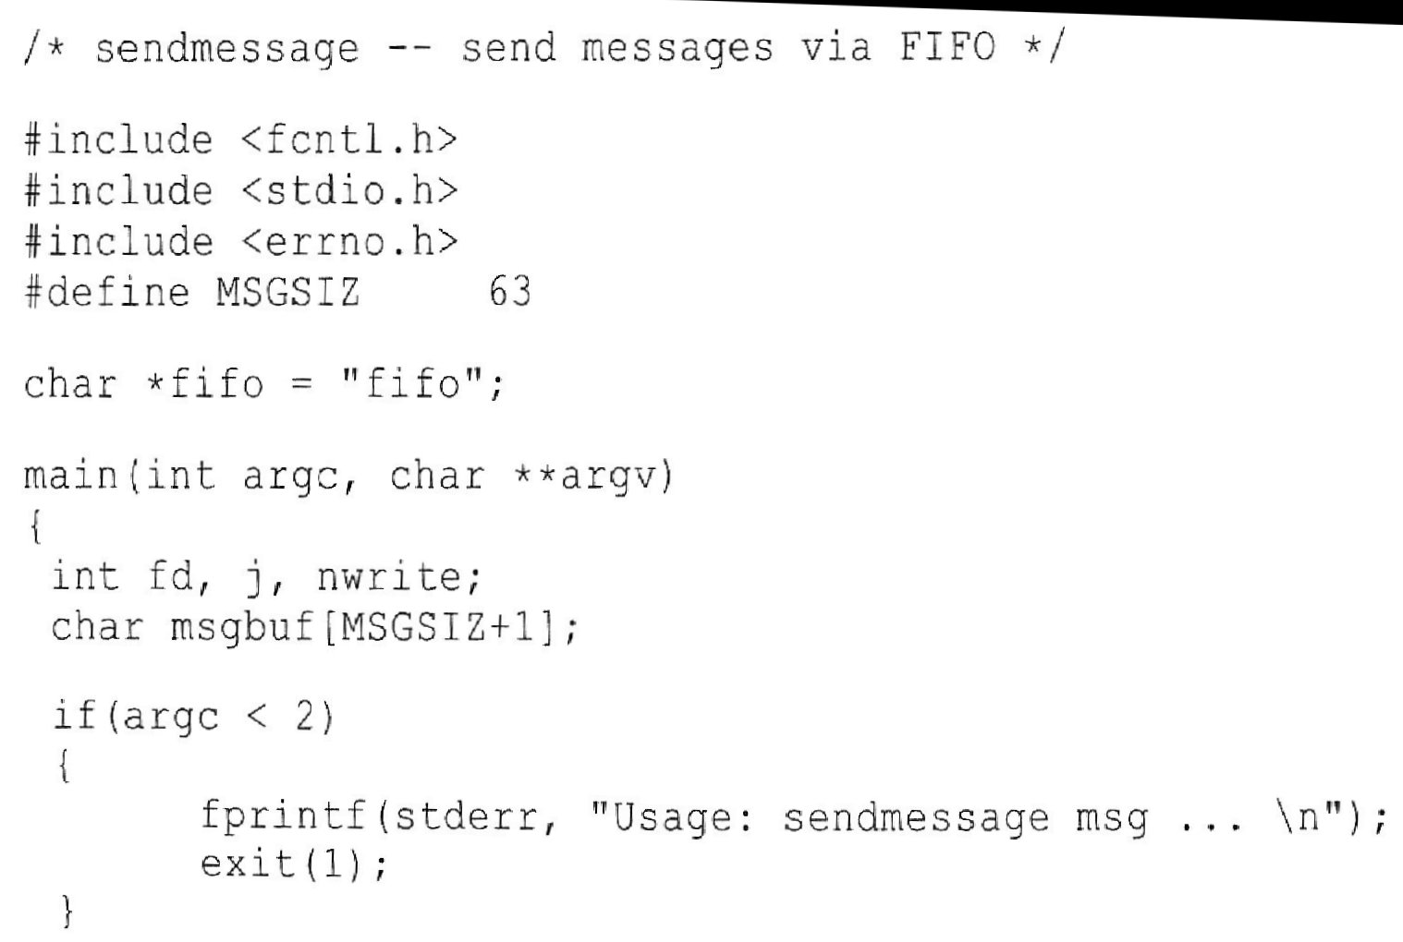
$ sendmessage ‘message text 1’ ‘message text 2’

Slide 58
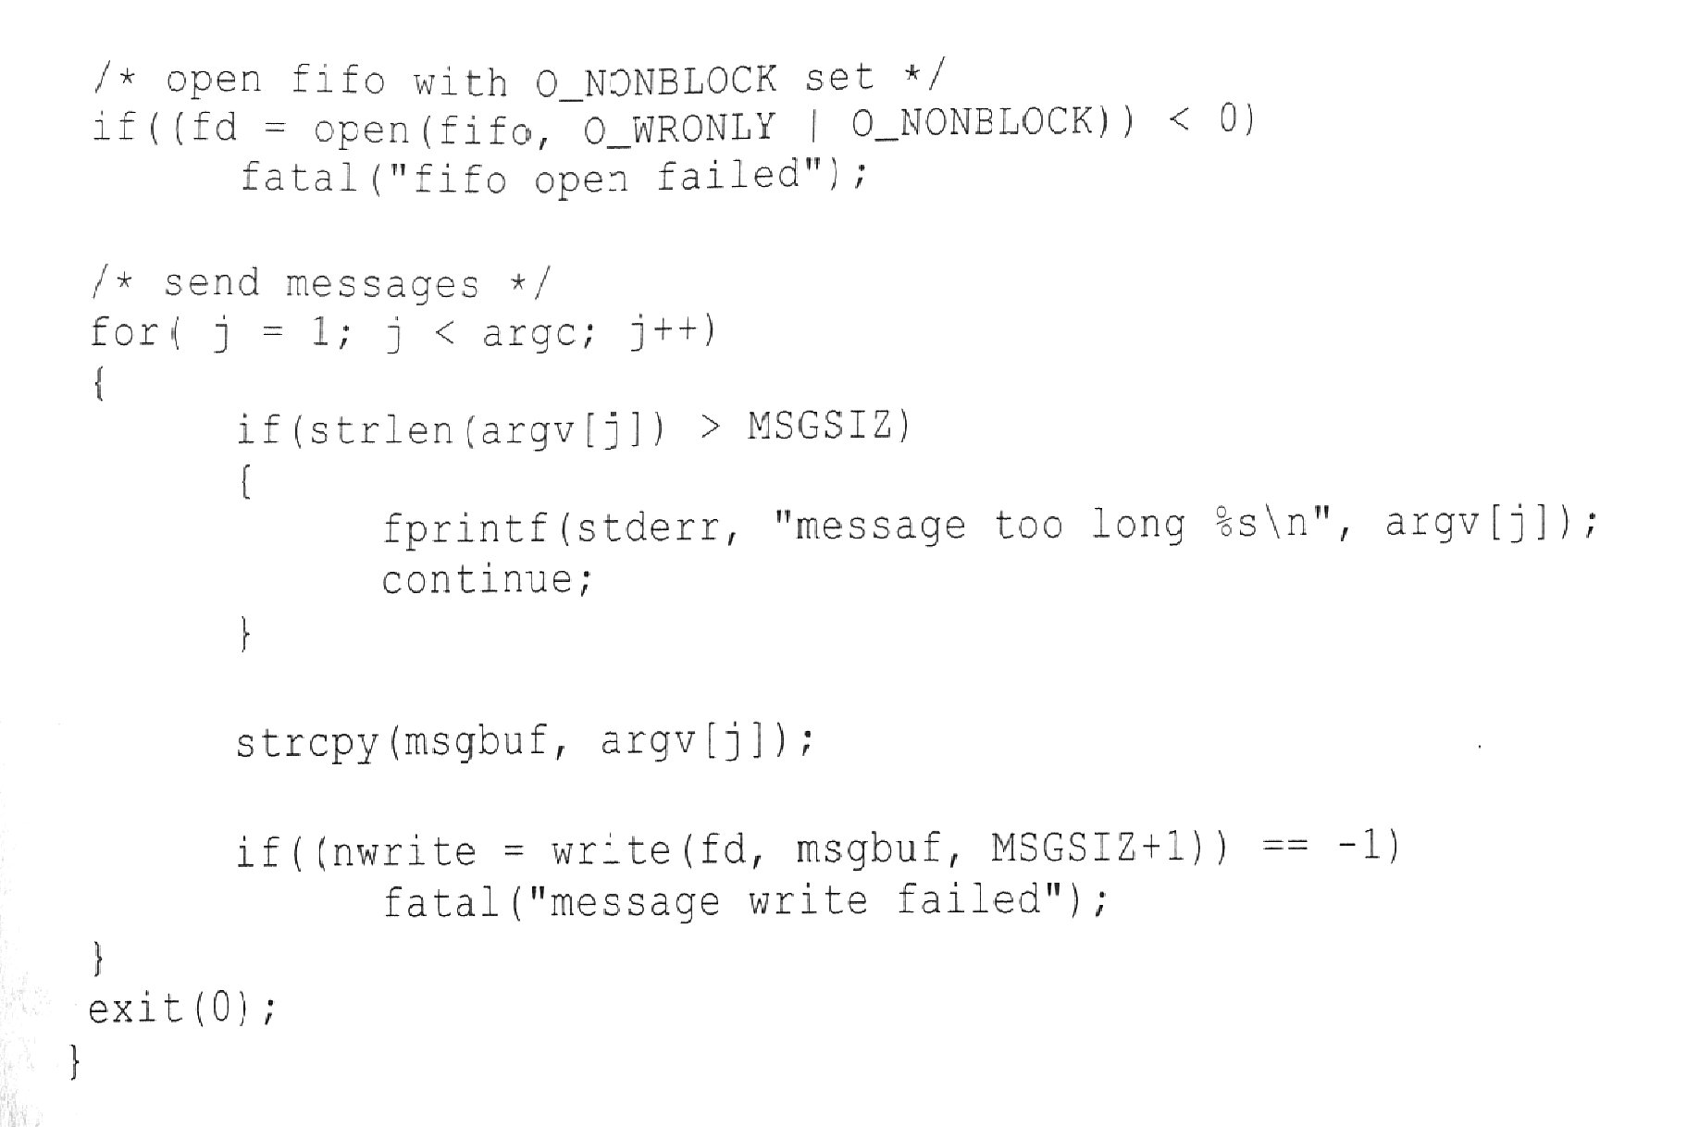

Slide 59
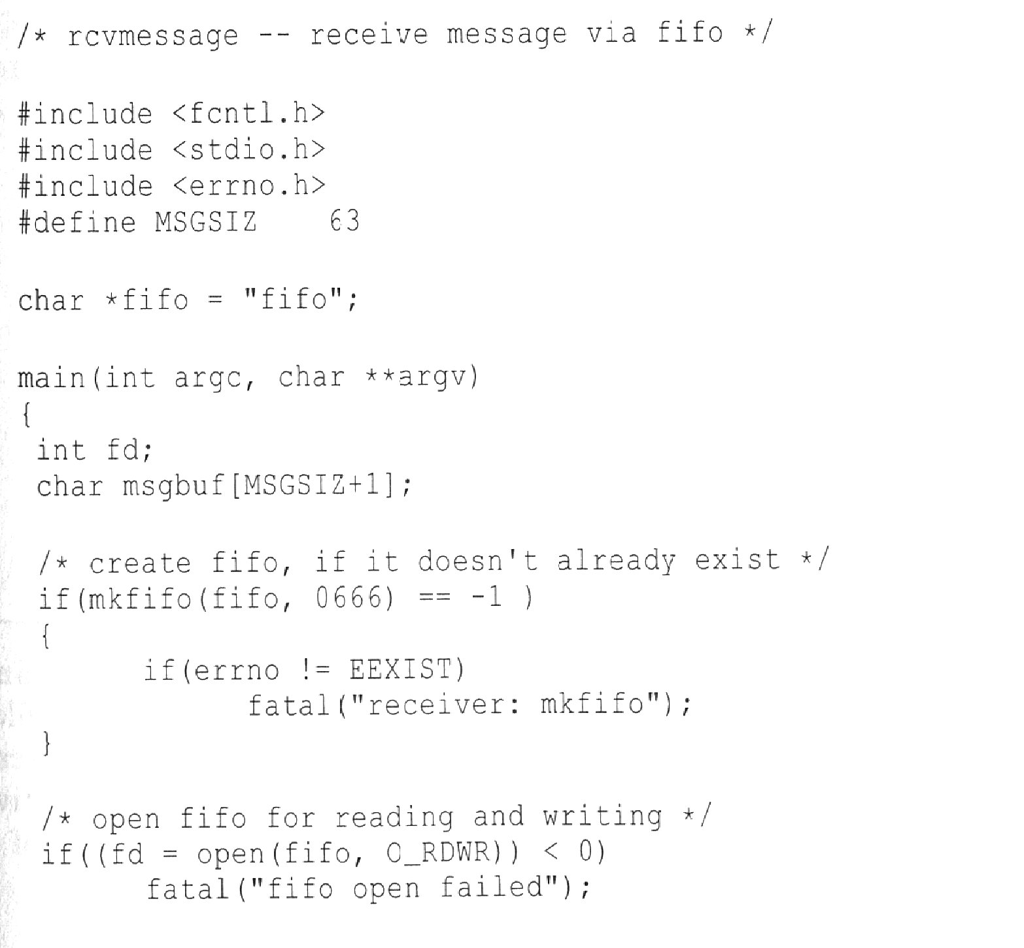

Slide 60
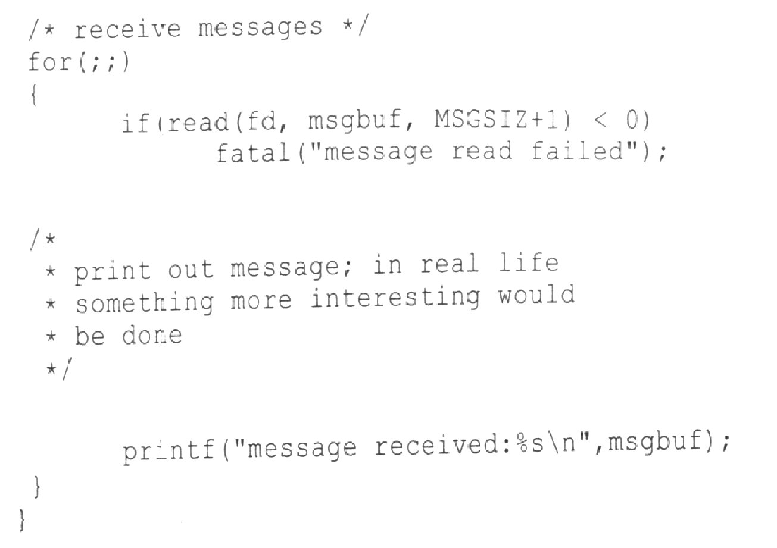

Slide 61
